Slide 1
24MAT120
S2 P & M

Slide 2
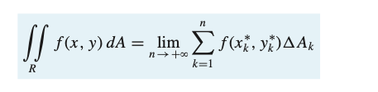
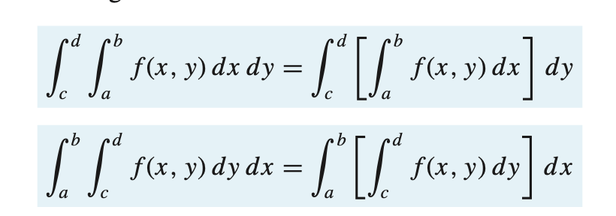

Slide 3
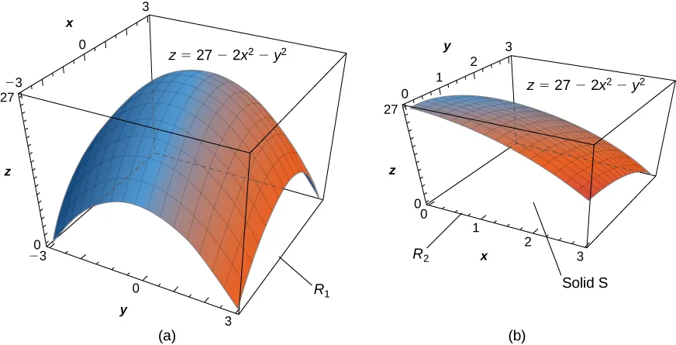

Slide 4
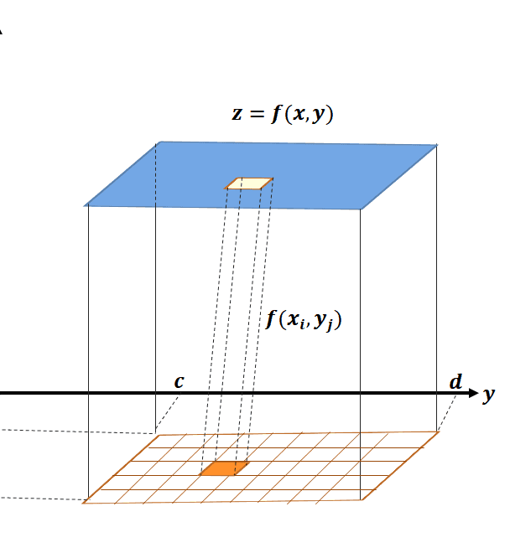
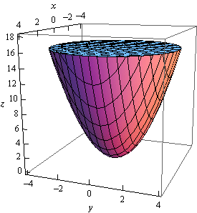

Slide 5
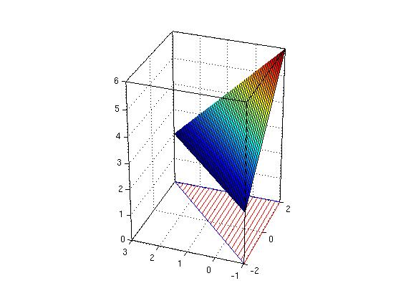
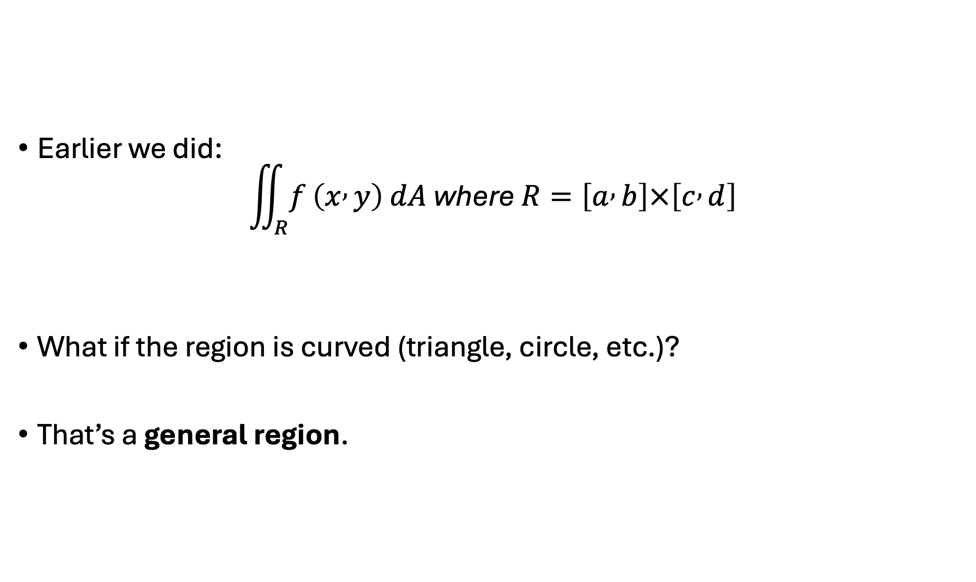
Earlier we did:
$$\iint_{R}{f}\left(x , y\right) dA \text{where} R=\left[a , b\right]×\left[c , d\right]$$
What if the region is curved (triangle, circle, etc.)?
That’s a general region.

Slide 6
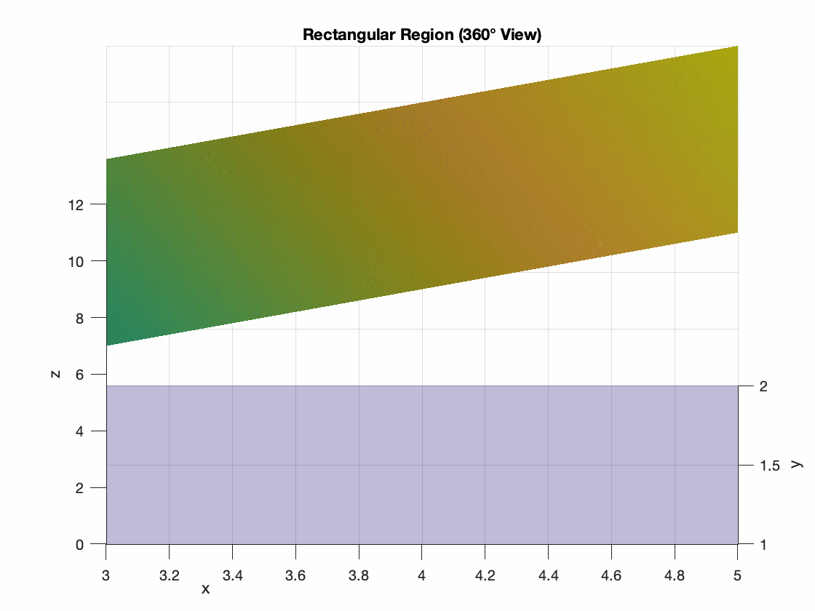

Slide 7
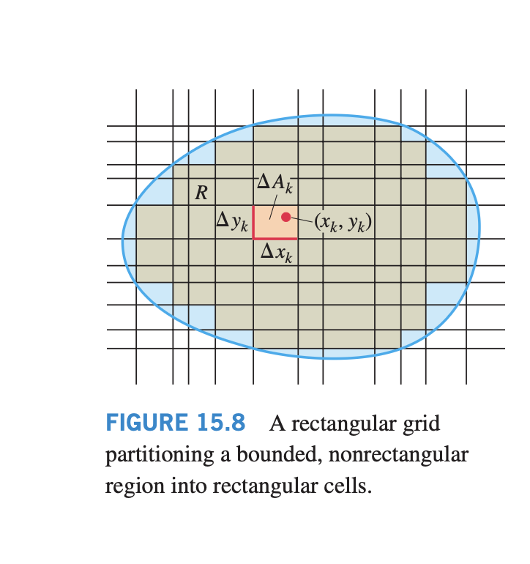
Double Integrals over Bounded, Nonrectangular Regions

Slide 8
To define the double integral of a function ƒ(x, y) over a bounded, nonrectangular region R, such as the one in Figure 15.8, we again begin by covering R with a grid of small rectangular cells whose union contains all points of R.
This time, however, we cannot exactly fill R with a finite number of rectangles lying inside R, since its boundary is curved, and some of the small rectangles in the grid lie partly outside R.
A partition of R is formed by taking the rectangles that lie completely inside it, not using any that are either partly or completely outside.
For commonly arising regions, more and more of R is included as the area of a partition (the largest width or height of any rectangle used) approaches zero.

Slide 9
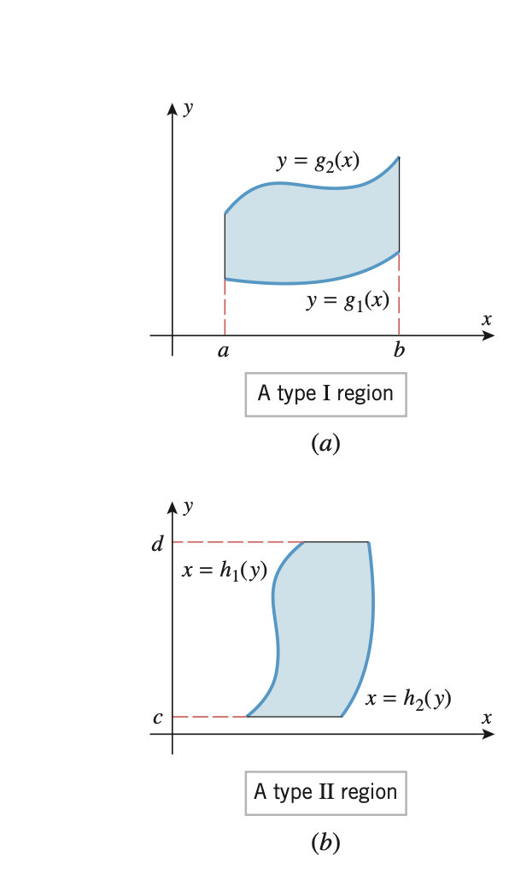
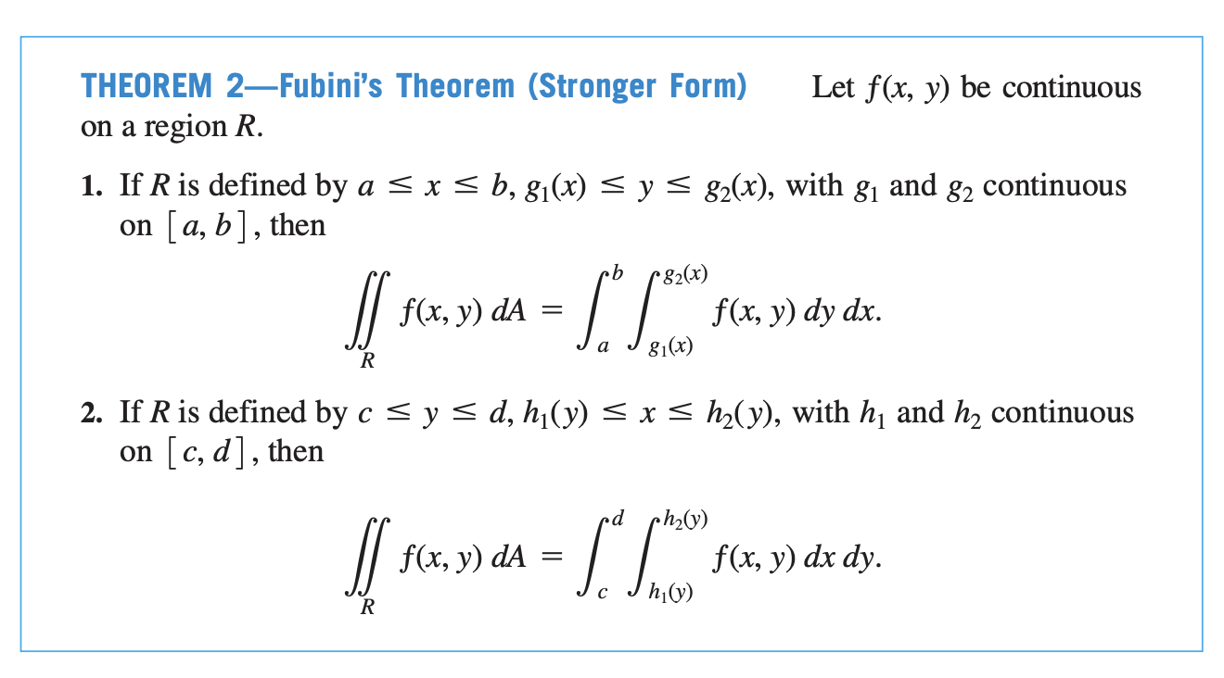

Slide 10
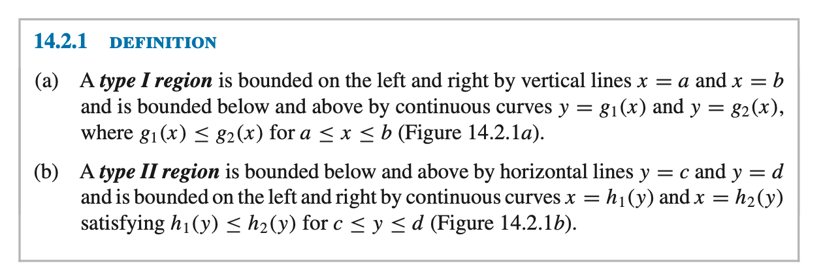

Slide 11
